Slide 1
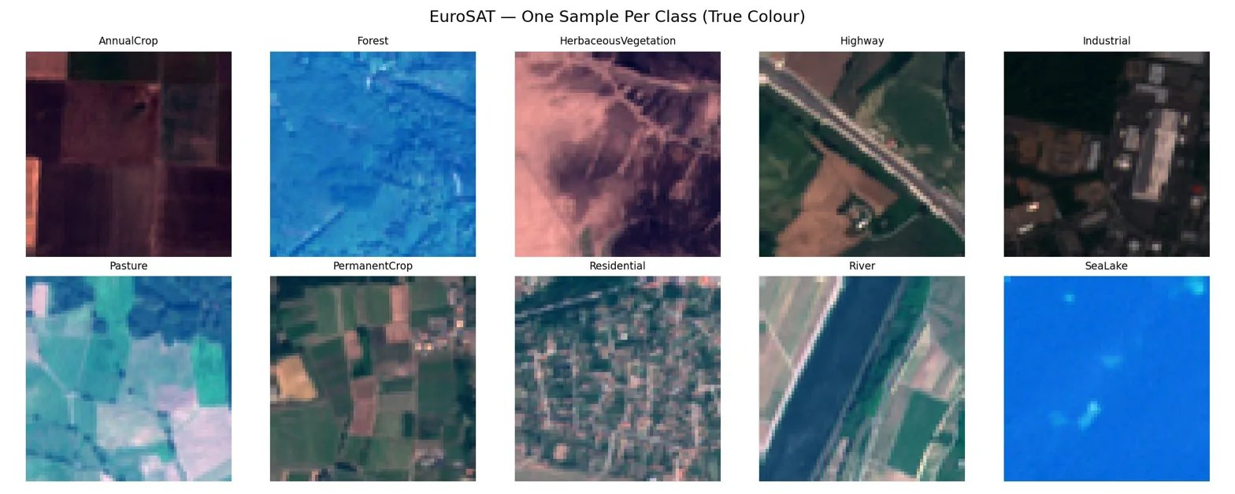
Satellite Scene
Classification
using ResNet-18 & EuroSAT Dataset
Team: fidalgovind | Adithyan Biju | Archana T
Course: Predictive Analytics
Dataset: EuroSAT | 16,200 images | 10 classes
Accuracy: 92.89% | Hamming Loss: 0.0711

Slide 2
Contents
01
Problem Statement & Motivation
09
Model Evaluation & Metrics
02
Dataset — EuroSAT Overview
10
Confusion Matrix Analysis
03
Project Pipeline (10 Stages)
11
Grad-CAM Explainability
04
Exploratory Data Analysis
12
Correct vs Wrong Predictions
05
Feature Engineering — NDVI
13
Streamlit Deployment
06
Data Preprocessing & Augmentation
14
Literature Review
07
Model Architecture — ResNet-18
15
Limitations & Future Work
08
Training Results
16
Conclusion

Slide 3
PROBLEM STATEMENT
What Are We Solving?
Classify 64×64 satellite image patches from Sentinel-2 into 10 distinct land-use categories using deep learning.
🌆
🌲
🌊
Urban Planning
Deforestation
Flood Detection
Track city growth and infrastructure expansion over time
Monitor forest cover loss for environmental protection
Identify water bodies and flood-risk zones rapidly
🌾
🏭
Agriculture
Industrial Watch
Monitor crop health and land productivity at scale
Track industrial zones for regulatory compliance

Slide 4
DATASET
EuroSAT Dataset Overview
16,200
10
64×64
13
Sentinel-2
Total Images
Land-Use Classes
Pixels per Patch
Spectral Bands
Satellite Source

Slide 5
METHODOLOGY
Project Pipeline — 10 Stages
01
02
03
04
05
Problem Definition
Data Collection
Preprocessing
EDA
Feature Engineering
06
07
08
09
10
Model Building
Model Evaluation
Explainability
Deployment
Documentation

Slide 6
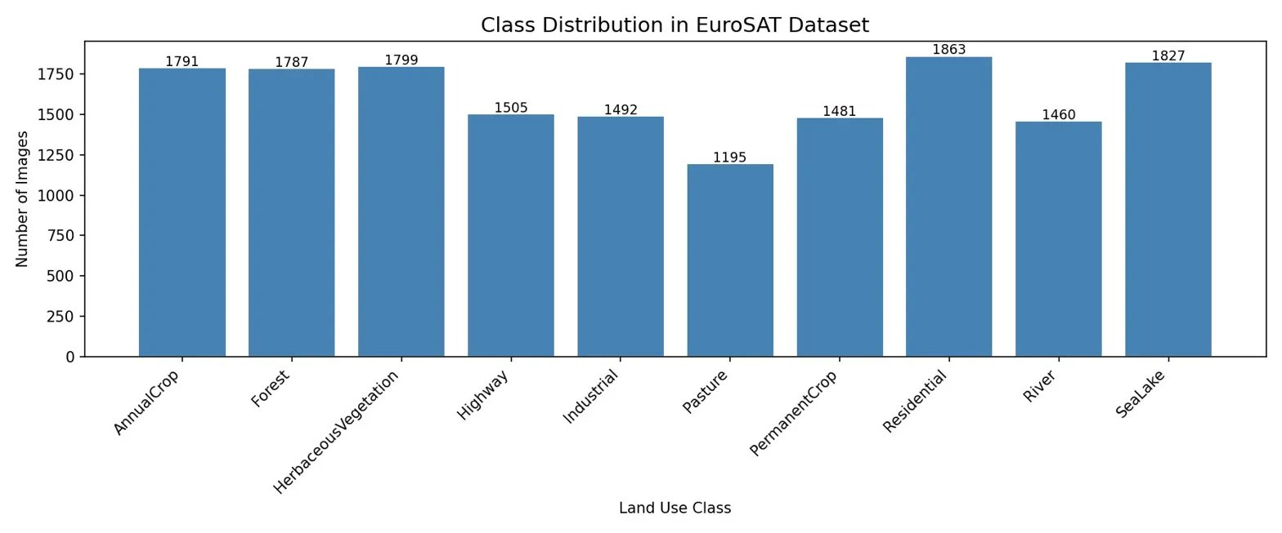
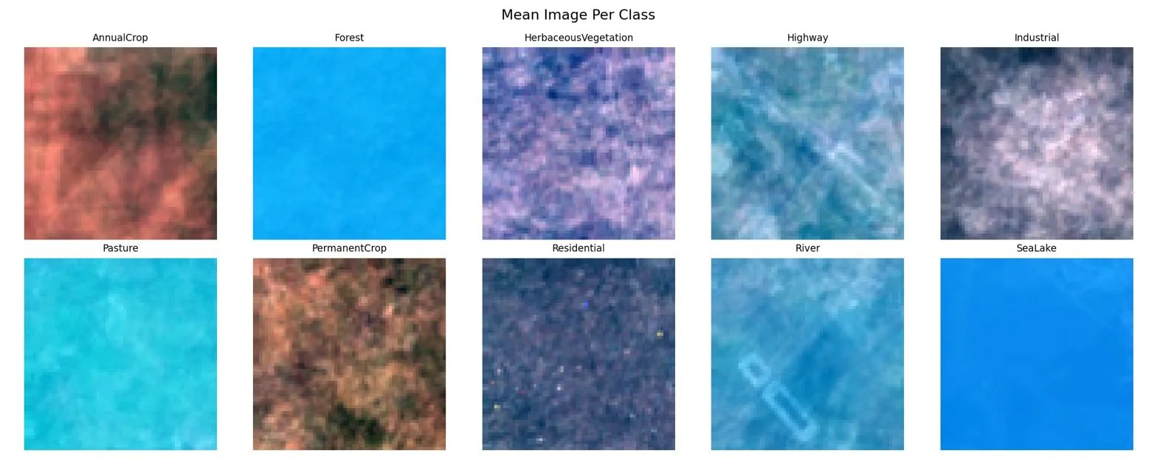
STAGE 4 — EDA
Exploratory Data Analysis
Class Distribution
Key Observations
~1,200–1,863 images per class — well balanced dataset
Pasture has fewest samples (1,195)
Residential has most samples (1,863)
No class imbalance — equal training representation
Mean Image Per Class

Slide 7
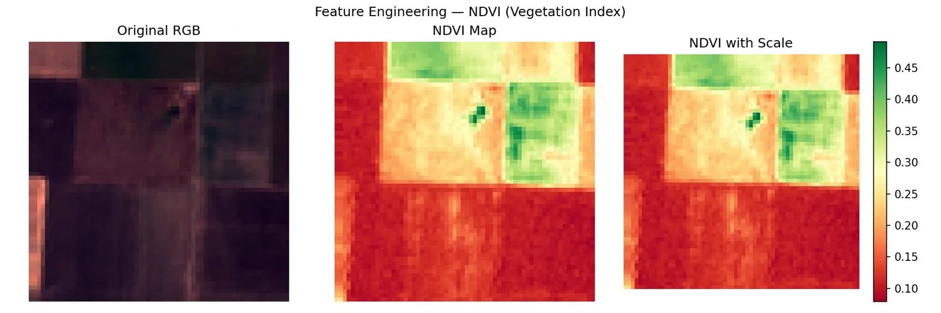
STAGE 5 — FEATURE ENGINEERING
NDVI — Vegetation Index
Formula:
NDVI = (NIR − Red)
/ (NIR + Red)
+1.0 Dense vegetation (Forest, Crops)
0.0 Sparse / transitional
−1.0 Water, roads, urban areas
Using Sentinel-2 Band 7 (NIR) and Band 3 (Red) to compute NDVI, which highlights vegetation density across each satellite patch.
Forest
HerbaceousVeg
SeaLake
Industrial
Highway
High NDVI
High NDVI
Very Low
Low NDVI
Low NDVI

Slide 8
STAGE 3 — PREPROCESSING
Data Preprocessing & Augmentation
Transforms Pipeline
Dataset Splits
Resize
All patches → 64×64 pixels (standardise input size)
Training
12,960
80%
RandomHFlip
Horizontal flip (50% probability — augmentation)
Validation
3,240
20%
RandomVFlip
Vertical flip (50% probability — augmentation)
Test
5,400
held-out
ColorJitter
Brightness ±20%, Contrast ±20% (robustness)
ToTensor
Convert PIL image → PyTorch float tensor
Batch Size: 32 | Shuffle: True (train) | Workers: 2
Normalize
Mean [0.485, 0.456, 0.406], Std [0.229, 0.224, 0.225]
Note: Test set transforms have NO augmentation — only Resize + Normalize to preserve evaluation integrity.

Slide 9
STAGE 6 — MODEL BUILDING
ResNet-18 Architecture
Input
3×64×64
Conv Layer
7×7, stride 2
ResNet
Blocks 1-4
AvgPool
+ Flatten
FC Layer
512 → 10
Softmax
10 classes
Pretrained: ImageNet (1M+ images)
Modified Layer: Final FC: 512 → 10 classes
Loss Function: CrossEntropyLoss
Optimizer: Adam (lr = 0.001)
Epochs: 5
Batch Size: 32
Key Insight: By using ImageNet pretrained weights, the model already understands low-level visual features (edges, textures, shapes). Fine-tuning on EuroSAT teaches it land-use-specific patterns.

Slide 10
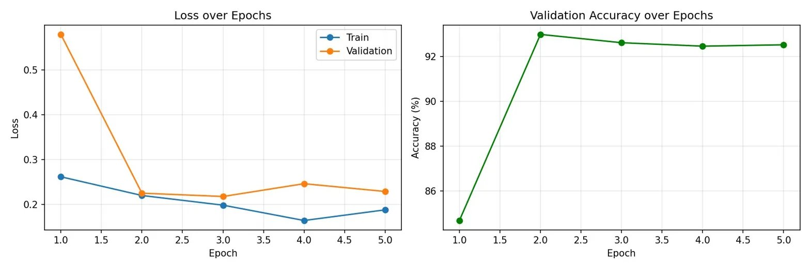
STAGE 6 — TRAINING
Training Results
Epoch Summary
Epoch | Val Acc
1 | 85.3%
2 | 93.4%
3 | 92.7%
4 | 92.5%
5 | 92.6%
Key Observations
Train loss decreases consistently over 5 epochs — confirming model is learning
Validation accuracy peaks at ~93.4% in Epoch 2, then stabilises around 92.5%
Val loss shows slight oscillation — normal for fine-tuned pretrained models
Best model checkpoint saved at Epoch 2 (highest val accuracy)

Slide 11
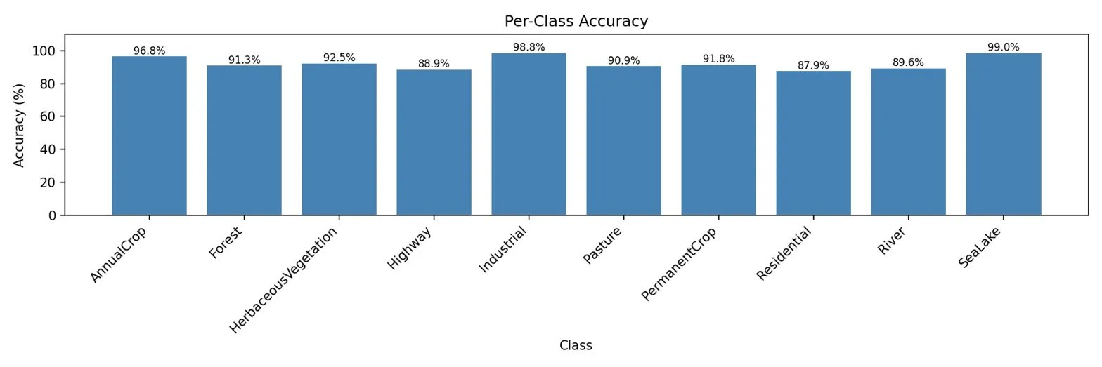
STAGE 7 — EVALUATION
Model Evaluation & Metrics
92.89%
0.0711
Overall Accuracy
Hamming Loss
Correctly classified patches out of 5,400 test images
Fraction of labels predicted incorrectly (lower = better)

Slide 12
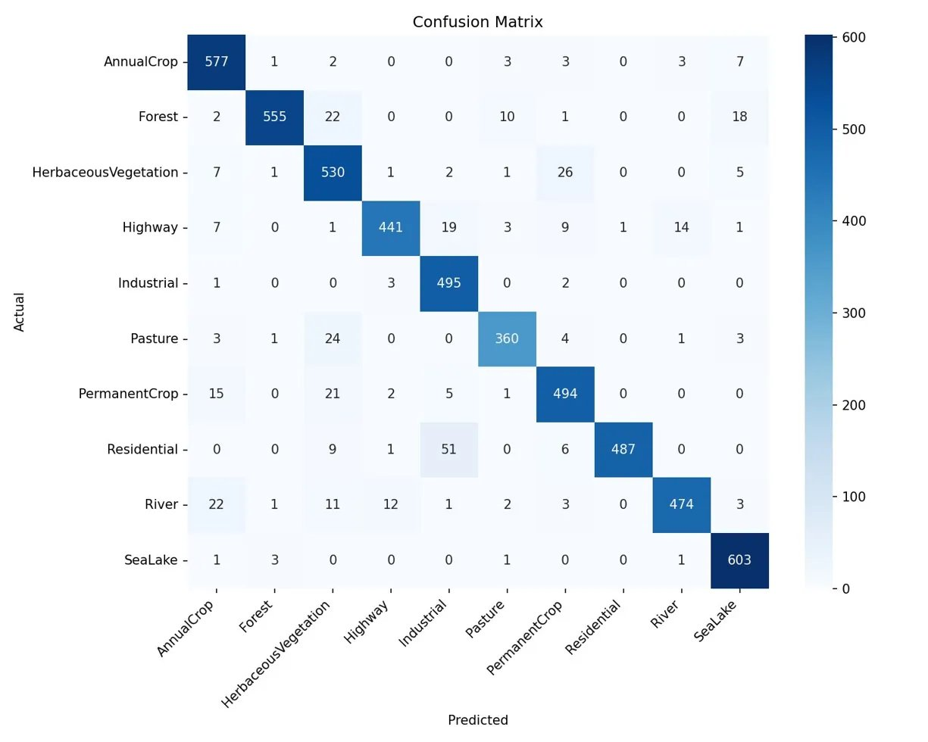
STAGE 7 — CONFUSION MATRIX
Confusion Matrix Analysis
Notable Patterns
SeaLake: 99% — nearly perfect, visually very distinct
Industrial: 99% — unique dark urban texture
AnnualCrop: 97% — field patterns easily identified
Residential: 88% — confused with Industrial
Highway: 89% — thin roads overlap with River
Pasture: 91% — confused with HerbVegetation
Strong diagonal = excellent multi-class discrimination

Slide 13
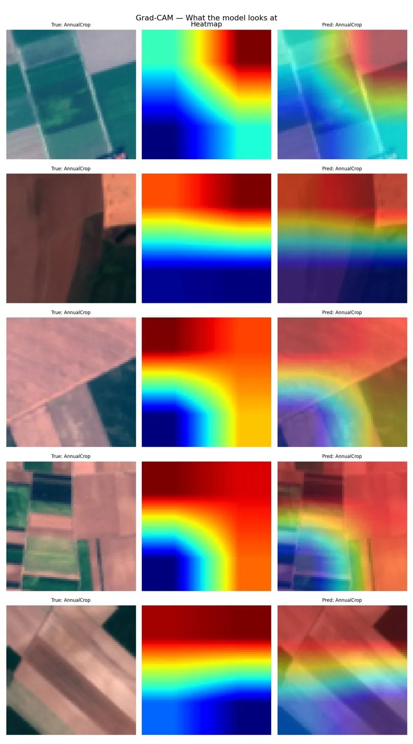
STAGE 8 — EXPLAINABILITY
Grad-CAM: What the Model Looks At
How Grad-CAM Works
Grad-CAM uses gradients flowing into the last convolutional layer to highlight regions most influential in the prediction.
🔴 Red / Warm: High attention — model focuses here
🔵 Blue / Cool: Low attention — ignored by model
Layer used: ResNet-18 layer4[-1]
Why It Matters
Grad-CAM confirms the model focuses on meaningful visual regions (field boundaries, water edges, road lines) — not background noise.

Slide 14
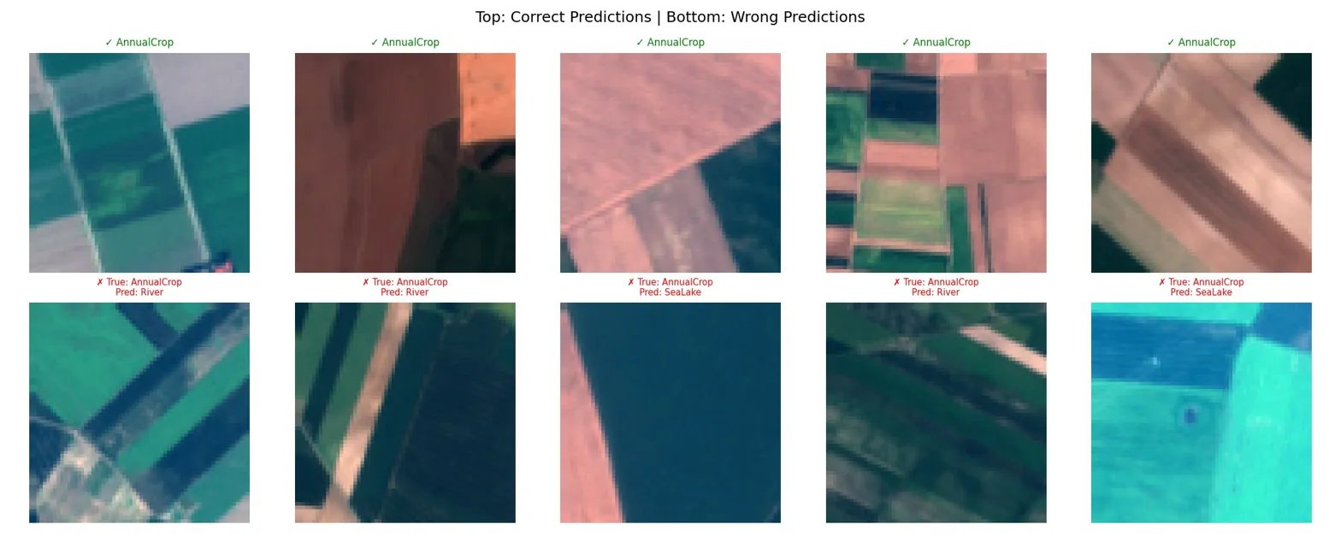
STAGE 7 — ANALYSIS
Correct vs Wrong Predictions
Analysis of Misclassifications:
AnnualCrop patches containing water channels are misclassified as River or SeaLake — the blue channel dominates. This is expected, since RGB-only data lacks the NIR channel that would distinguish vegetation from water more precisely.

Slide 15
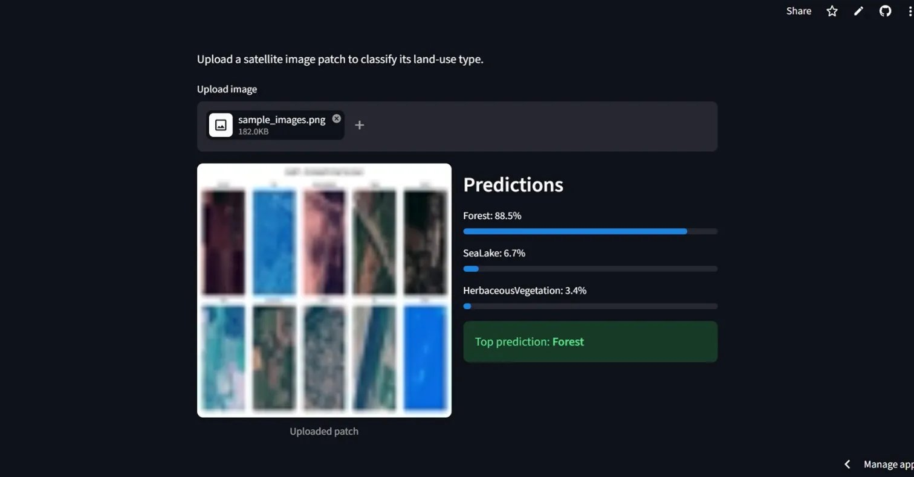
STAGE 9 — DEPLOYMENT
Streamlit Live Deployment
🔗 Live URL
satellite-scene-classification-
4remxga6jkwsfybr79ivjq.
streamlit.app
App Features:
Upload any satellite image patch
Top-3 class predictions
Confidence percentages shown
Instant classification result
Model loads from Google Drive
Tech Stack:
Streamlit • PyTorch • ResNet-18 • gdown

Slide 16
REFERENCES
Literature Review
01
EuroSAT: A Novel Dataset and Deep Learning Benchmark for Land Use and Land Cover Classification
Helber et al., 2019 — IEEE Journal of Selected Topics in Applied Earth Observations
Introduced the EuroSAT dataset. Demonstrated that CNNs outperform traditional remote sensing methods. Achieved 98.57% accuracy on RGB images using ResNet-50, establishing the benchmark we are working against.
02
Deep Residual Learning for Image Recognition
He et al., 2016 — IEEE CVPR (Highly Cited)
Introduced ResNet with skip connections that solve the vanishing gradient problem. ResNet-18 has 18 layers and ~11M parameters. The skip connections allow gradients to flow directly, enabling effective training of deeper networks.
03
Grad-CAM: Visual Explanations from Deep Networks via Gradient-based Localization
Selvaraju et al., 2017 — IEEE ICCV
Proposed Gradient-weighted Class Activation Mapping. Computes gradient of predicted class w.r.t. final conv layer feature maps to produce class-discriminative localization maps, making predictions interpretable without architectural changes.

Slide 17
Conclusion &
Future Work
Key Achievements
Future Work
92.89% test accuracy on EuroSAT with ResNet-18
Use all 13 Sentinel-2 bands — RGB only misses NIR data
Hamming Loss of only 0.0711
Try EfficientNet / ViT — Higher accuracy potential
SeaLake class: 99% accuracy
BigEarthNet multi-label — Multi-label classification
Grad-CAM confirms model interpretability
Live Streamlit deployment with real-time inference
Real-time satellite feed — Live environmental monitoring
Collaborative GitHub workflow with equal contributions
Explainability for all classes — Full Grad-CAM coverage
fidalgovind | Adithyan Biju | Archana T — Predictive Analytics Course

